Slide 1

Revolutionising B.Tech

Slide 2
Unit 4: Module
Modules, Files and Inheritance

Slide 3
Introduction: Module
A module is a file containing Python definitions and statements.
Modules act as a pre-defined library in the script
The file name is the module name with the suffix .py appended.
Within a module, the module’s name (as a string) is available as the value of the global variable __name__.
The python modules also store pre-defined functions from the library when the code is being executed.
We have imported the required module and used the pow() function to calculate the powers of the given number as arguments. We have then printed the value of the pow for the user.
For instance, use your favourite text editor to create a file called fibo.py in the current directory with the following contents:

Slide 4
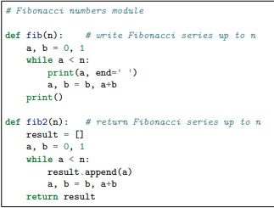

Modules
Example. Create a file called fibo.py in the current directory with the following contents:
Now enter the Python interpreter and import this module with the following command:

Slide 5

Modules
This does not enter the names of the functions defined in fibo directly in the current symbol table
It only enters the module name fibo there.
Using the module name you can access the functions:

Slide 6
Modules
A module can contain executable statements as well as function definitions.
These statements are intended to initialize the module.
They are executed only the first time the module name is encountered in an import statement.
Each module has its own private symbol table, which is used as the global symbol table by all functions defined in the module.
Thus, the author of a module can use global variables in the module without worrying about accidental clashes with a user’s global variables.
On the other hand, if you know what you are doing you can touch a module’s global variables with the same notation used to refer to its functions, modname.itemname.
Modules can import other modules. It is customary but not required to place all import statements at the beginning of a module
The imported module names are placed in the importing module’s global symbol table.

Slide 7
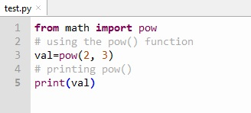
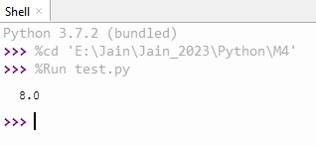
Modules
There is a variant of the import statement that imports names from a module directly into the importing module’s symbol table. For example:
from math import pow
# using the pow() function
val=pow(2, 3)
# printing pow()
print(val)
# Output
# 8.0

Slide 8



Modules
Example 2
From module fibo, import two methods fib and fib2.
Import all module, except those beginning with an underscore (_).
If the module name is followed by as, then the name following as is bound directly to the imported module.

Slide 9


Executing Module as a Script
You can make the file usable as a script as well as an importable module.
if you want to use a Python module as script then you just have to use the conditional for __name__.
When you run a Python module with, python fibo.py <arguments>
The code that parses the command line only runs if the module is executed as the “main” file:
Example

Slide 10
The Module Search Path
When a module named spam is imported, the interpreter first searches for a built-in module with that name.
If not found, it then searches for a file named spam.py in a list of directories given by the variable sys.path. sys.path is initialized from these locations:
The directory containing the input script
PYTHONPATH (a list of directory names, with the same syntax as the shell variable PATH).
The installation-dependent default.

Slide 11
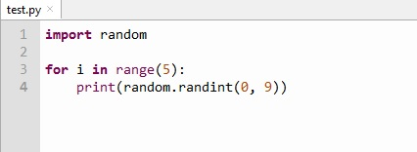
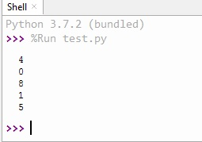
Reload a Module
Reload() is used to reload, a previously imported module.
When reload() is executed, the module code is recompiled and module-level code is re executed.
The old objects are reclaimed after the reference and the count came to zero.
Example

Slide 12
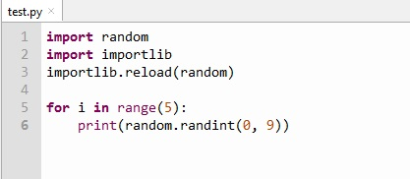
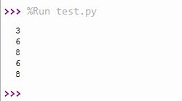
Reload a Module
Example 2

Slide 13
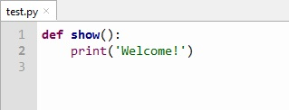
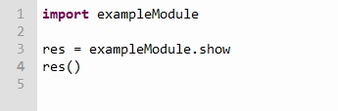
Reload a Module
Example 3
Create a python module named, examplemodule.py
It has a function show() that displays "Welcome!".
create another file named example.py which will import the exampleModule.py as the following:

Slide 14
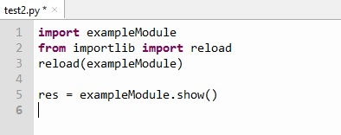
Reload a Module
The result will show “Welcome!”

Slide 15
Packages
We organize a large number of files in different folders and subfolders based on some criteria, so that we can find and manage them easily.
In the same way, a package in Python takes the concept of the modular approach to next logical level.
A module have multiple objects like, functions , class etc.
A package can contain one or more relevant modules.
Physically, a package is actually a folder containing one or more module files.

Slide 16
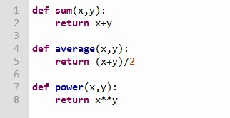
Packages
Creating New Package
Create a new folder named “mypackage”
Create an empty “__init__.py” file in this folder.
Use any editor and create two modules named “M1” and “Function1”
M1.py
def SayHello(name):
print("Hello ", name)
Function1.py

Slide 17
Packages
Now, under the folder;, we create the package named “mypackage”
Next, we want to import a module from the package.
We use,
>>> from mypackage import Function1 >>> function1.power(3,2) 9
It will return the result 9.
It is also possible to import specific functions from a module in the package.
>>> from mypackage.function1 import sum >>> sum(10,20) 30

Slide 18

Packages
__init__.py
The package folder have a special file called __init__.py, which stores the package's content.
It have two purpose.
The Python interpreter recognizes a folder as the package if it contains __init__.py file.
__init__.py exposes specified resources from its modules to be imported.
An empty __init__.py file makes all functions from the above modules available when this package is imported.
The __init__.py file is normally kept empty. However, it can also be used to choose specific functions from modules in the package folder and make them available for import.
Example
--init__.py

Slide 19

Packages
We change –init--.py as above.
Create a new file named, Test.py.
Test.py
Note that functions power() and SayHello() are imported from the package and not from their respective modules, as done earlier.

Slide 20
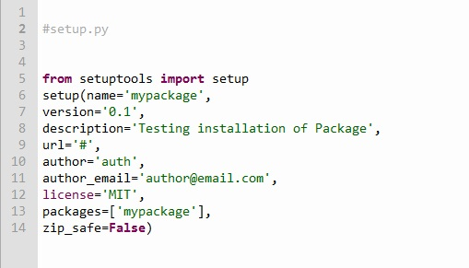
Packages – Install Globally
Once a package is created, it can be installed for system-wide use by running the setup script.
The script calls setup() function from the setuptools module.
Lets install mypackage for system-wide use by running a setup script.
Save the following code as setup.py in the parent folder MyApp.
Setup.py

Slide 21
Packages – Install Globally
The script calls the setup() function from the setuptools module.
The setup() function takes various arguments such as name, version, author, list of dependencies, etc.
The zip_safe argument defines whether the package is installed in compressed mode or regular mode.
Now execute the following command to install mypackage using the pip utility.
Ensure that the command prompt is in the parent folder
D:\MyApp>pip install mypackage
You will get the message lke..
Processing d:\MyApp Installing collected packages: mypack Running setup.py install for mypack ... done Successfully installed mypackage-0.1
Now mypackage is available for system-wide use and can be imported in any script or interpreter.
>>> import mypackage or >>>mypackage.average(10,20)

Slide 22
Libraries
Python library is a reusable chunk of code that you may want to include in your programs/ projects.
‘library’ loosely describes a collection of core modules.
A package is a library that can be installed using a package manager like rubygems or npm.
Python Standard Library
The Python Standard Library is a collection of exact syntax, token, and semantics of Python.
It comes bundled with core Python distribution.
It is written in C, and handles functionality like I/O and other core modules.
All this functionality together makes Python the language it is.
More than 200 core modules sit at the heart of the standard library. This library ships with Python.

Slide 23
Important Python Libraries
Matplotlib
Matplotlib is a powerful and very popular data visualization library in Python.
These are the foundational plots that helps to understand, visualizing, and telling stories about data.
Matplotlib is one of the most popular libraries for creating data visualizations.
Very flexible and customizable for creating plots.
A lot of code to make more basic plots with little customizations.
Matplotlib is designed to work with NumPy arrays and pandas dataframes.
The library makes it easy to make graphs from tabular data.
Using following statement, we can import matplotlib in our program module.
import matplotlib.pyplot as plt

Slide 24
Important Python Libraries
Pandas
It provides fast, expressive, and flexible data structures to easily work with structured like tabular, multidimensional, potentially heterogeneous data and time-series data.
pandas is a data manipulation package in Python for tabular data.
Data in the form of rows and columns, also known as DataFrames.
DataFrame as an Excel sheet.
Most important Python package for data analysis.
de facto standard package for data manipulation and exploratory data analysis.
The ability to read from and write to an extensive list of formats makes it a versatile tool for data science practitioners.
Its data manipulation functions make it a highly accessible and practical tool for aggregating, analyzing, and cleaning data.
functionality includes data transformations, calculating summary statistics such as the mean, joining DataFrames together etc.

Slide 25
Important Python Libraries
Pandas
Install Pandas, we use following statement
pip install pandas
Importing pandas in our script, we use
import pandas as pd

Slide 26
Important Python Libraries
NumPy
Python library that provides a simple yet powerful data structure: the n-dimensional array.
Few advantages of NumPy are..
More speed: NumPy uses algorithms written in C that complete in nanoseconds rather than seconds.
Fewer loops: NumPy helps you to reduce the loops.
Clearer code: Without loops, your code will look more like the equations you’re trying to calculate.
Better quality: There are thousands of contributors working to keep NumPy fast, friendly, and bug free.
Is the de facto standard for multidimensional arrays in Python data science
Install NumPy.
pip install numpy.

Slide 27
Important Python Libraries
SQLAlchemy
Is a python SQL tool kit.
Allows developers to access and manage SQL databases using Pythonic domain language.
You can write a query in the form of a string or chain Python objects for similar queries.
Working with objects provides developers flexibility and allows them to build high-performance SQL-based applications.
Install SQLAlchemy
pip install sqlalchemy
Importing SQLAlchemy
>>> import sqlalchemy
There are other python libraries are available like SciPy, Scrapy, PyGame etc..

Slide 28
Date and Time
The datetime module is used to modify date and time objects in various ways. It contains five classes to manipulate date and time.
They are as follows:
Date: deals with date objects.
Time: deals with time objects.
datetime: deals with date and time object combinations.
timedelta: deals with intervals of time. Used in calculations of past and future date and time objects.
Info: deals with time zone info of local time.

Slide 29
Importing datetime module:
>>import datetime
>>from datetime import date
>>from datetime import time
>>from datetime import datetime

Slide 30
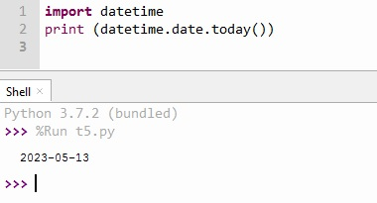
To display today’s date:
import datetime
print (datetime.date.today())

Slide 31
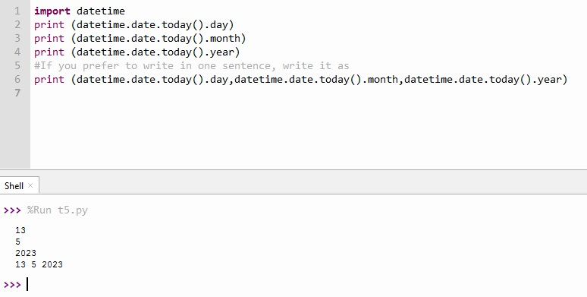
To view the individual date components:
import datetime
print (datetime.date.today().day)
print (datetime.date.today().month)
print (datetime.date.today().year)
#If you prefer to write in one sentence, write it as
print (datetime.date.today().day,datetime.date.today().month,datetime.date.today().year)

Slide 32
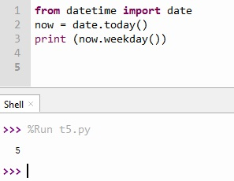
To find out the weekday of the current date
from datetime import date
now = date.today()
print (now.weekday())

Slide 33
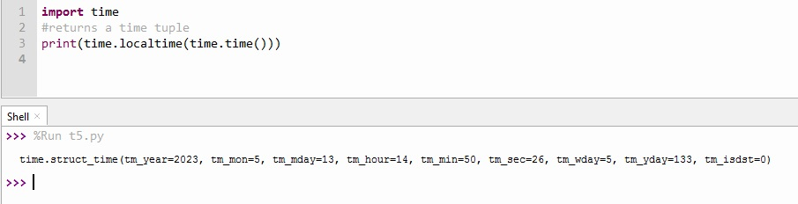
How to get the current time?
The localtime() functions of the time module are used to get the current time tuple.
import time
#returns a time tuple
print(time.localtime(time.time()))

Slide 34
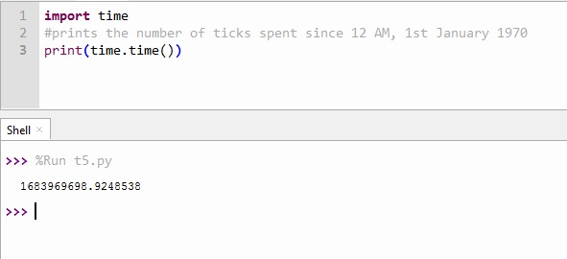
time() function:
The function time() of the module time returns the total number of ticks spent since 12 AM, 1st January 1970. A tick can be seen as the smallest unit to measure the time.
import time;
#prints the number of ticks spent since 12 AM, 1st January 1970
print(time.time())

Slide 35
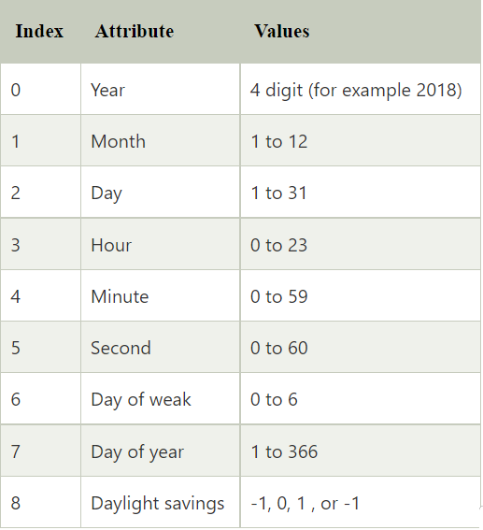
Time tuple:
The time is treated as the tuple of 9 numbers

Slide 36
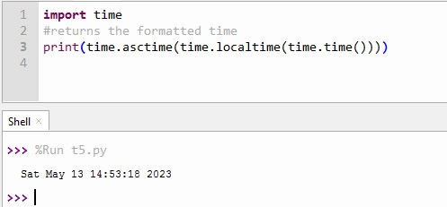
asctime() Function
The time can be formatted by using the asctime() function of the time module. It returns the formatted time for the time tuple being passed.
import time
#returns the formatted time
print(time.asctime(time.localtime(time.time())))

Slide 37
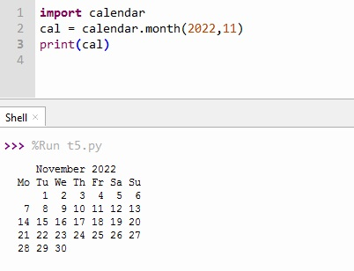
The calendar module:
import calendar cal = calendar.month(2022,11) print(cal)

Slide 38
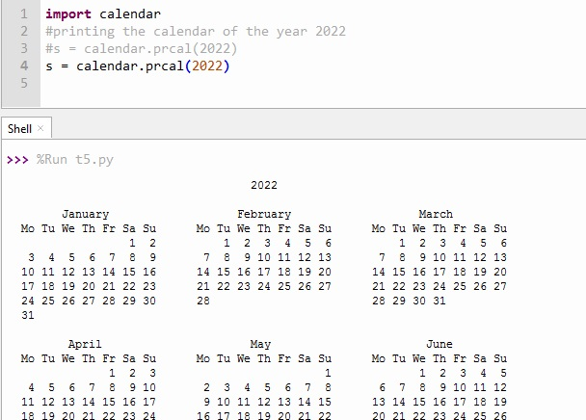
Printing the calendar of whole year:
The prcal() method of calendar module is used to print the calendar of the entire year. The year of which the calendar is to be printed must be passed into this method.
import calendar
#printing the calendar of the year 2022
s = calendar.prcal(2022)

Slide 39
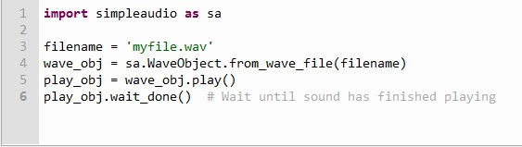
Sound Library
You have to import the library playsound
>> from playsound import playsound
>>playsound('myfile.wav')
Another Library is simpleaudio
Example

Slide 40
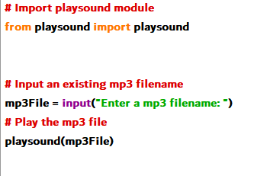
Sound: Example

Slide 41
Downloading files from web using Python
Different modules like urllib, requests etc to download files from the web.
Steps
1. Import the module
>>import requests
2. Get the link or url
>> url = 'https://www.facebook.com/abcd.ico‘
>> r = requests.get(url, allow_redirects=True)
3. Save the content with name.
>> open('facebook.ico', 'wb').write(r.content)

Slide 42
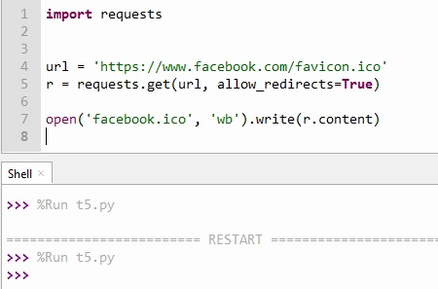
Downloading files from web using Python
Example
Visit the present working directory, the file will be there.

Slide 43
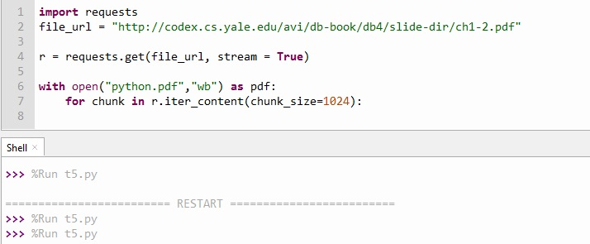
Downloading files from web using Python
Example – Download PDF file from web and save into PC
Visit the present working directory, the file will be there.

Slide 44
File handling in Python
It involves the reading and writing from a given file.
The built-in Python methods can manage two file types, text and binary files, but they encode data differently.
A text file consists of a series of lines.
Text files don’t have any specific encoding and it can be opened in normal text editor itself.
Web Standard files – HTML, XML, CSS, JSON etc
Source Code - C, app, JS, Py etc..
Documents - .doc, .docx, .txt etc.
Tabular data - .CSV, .tsv etc
Configuration files – ini, cfg, reg etc.

Slide 45
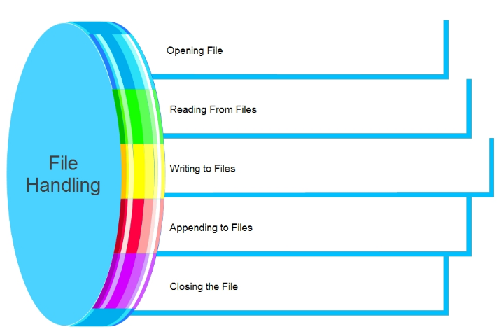
File handling Operations
Most importantly there are 4 types of operations that can be handled by Python on files:
Open
Read
Write
Close
Other operations include:
Rename
Delete

Slide 46
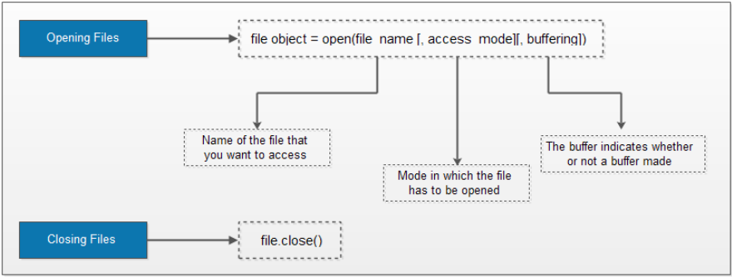
File handling Operations – Open File
Syntax of the file open function:
file object = open(file_name [, access_mode][, buffering])

Slide 47
File handling Operations – Open File
<file_name> – It’s a string refers to the file you want to access.
<access_mode> – The access_mode sets the mode to open the file,e.g., read, write, append, and so on.
The parameter is optional. It is set to read-only <r> by default. In this mode, after reading from the file, we get data in text form.
The binary mode, on the other hand, returns bytes. It is best to access non-text files such as an image or Exe files.
<buffering> – The buffer indicates whether or not a buffer made.
The default value is 0, meaning that buffering will not occur.
When the value is 1, line buffering occurs when you access the file.
If it is more than 1, the buffer action will execute according to the buffer size. The default behaviour considered in the case of a negative value.

Slide 48
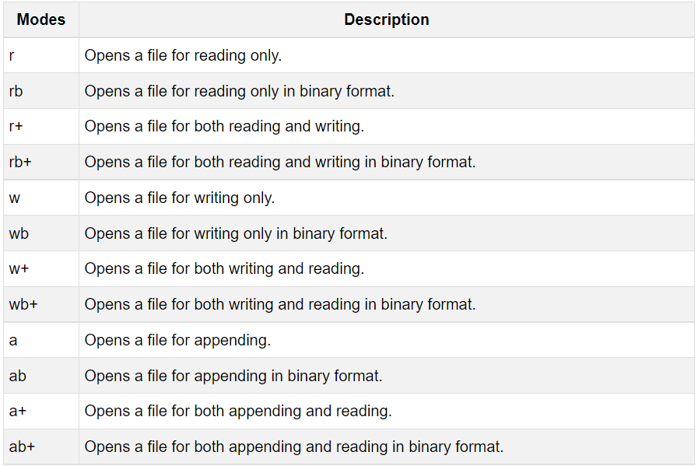
Python File Modes

Slide 49
File handling Operations – File Read
There are three ways in which we can read the files in python.
read([n])
readline([n])
readlines()
Here, n is the number of bytes to be read.

Slide 50
File handling Operations – File Read
#read the entire file
# a file named "file", will be opened with the reading mode.
file = open('file.txt', 'r')
# Each line will be printed one by one in the file
for each in file:
print (each)
#o/p
Hello how are you?

Slide 51
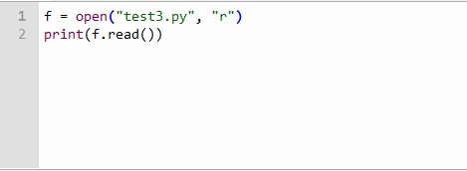
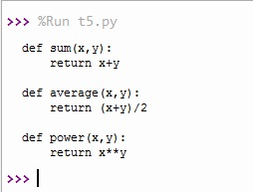
File handling Operations – File Read
Example
Output

Slide 52

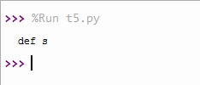
File handling Operations – File Read
Python code to illustrate read() mode character wise
Example
Output – return the fifth character

Slide 53
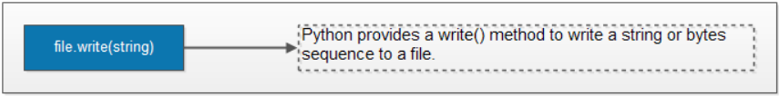
File handling Operations – File Write
Opening a file to write.
Appending and writing to a file.
Closing a file
Python offers built-in functions to open, write, read, close and delete files.

Slide 54
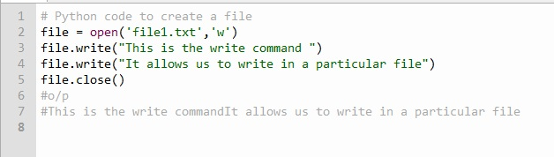
File handling Operations – File Write
In order to write data into a file, we must open the file in write mode.
We have two methods for writing data into a file as shown below.
write(string)
writelines(list)
Example

Slide 55
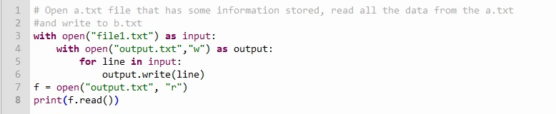

File handling Operations – File Write
Example - # Open file1.txt file that has some information stored, read all the data from the output.txt
and write to output.txt
Output

Slide 56
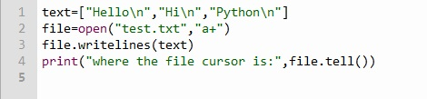

File handling Operations – tell() Method
Example
Here, you can observe that we have used the tell() method which prints where the cursor is currently at.

Slide 57
File handling Operations – seek() Method
Syntax
seek(offset):
The offset takes three types of arguments namely 0,1 and 2.
#When the offset is 0: Reference will be pointed at the beginning of the file.
#When the offset is 1: Reference will be pointed at the current cursor position.
#When the offset is 2: Reference will be pointed at the end of the file.

Slide 58
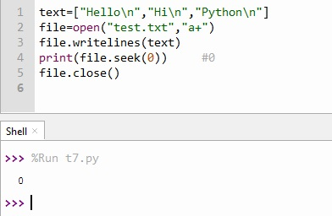
File handling Operations – seek() Method
Example – seek()
Points zero’th position

Slide 59
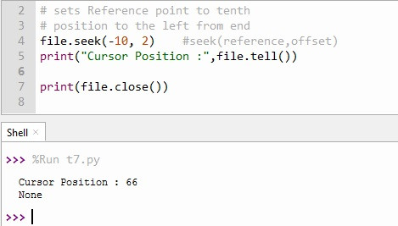
File handling Operations – seek() Method
Example – seek()
Points last position position

Slide 60
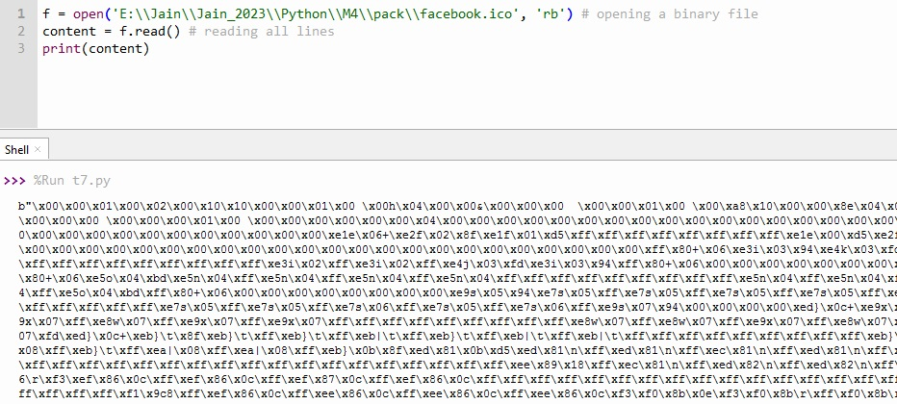
Reading Binary file
Use the 'rb' mode in the open() function to read a binary files.
Syntax
open(“file location”, “rb)
Example

Slide 61
File Using With statement
With keyword in python use as context manager.
It will automatically release files once its usage is complete.
It is a standard practice is generally used with context manager.
It is necessary that, make sure of release the resources after usage.
If they are not released, then it will lead to resource leakage and may cause the system to either slow down or crash.
Thus we use with context manager.
Syntax
with open(file_path, mode, encoding) as file:
file_path: It is the path to the file to open
mode: mode of operation on the file. ex.: read, write etc. (represented by r, w, r+, w+, rb, wb etc.)
encoding: read the file in correct encoding format.

Slide 62
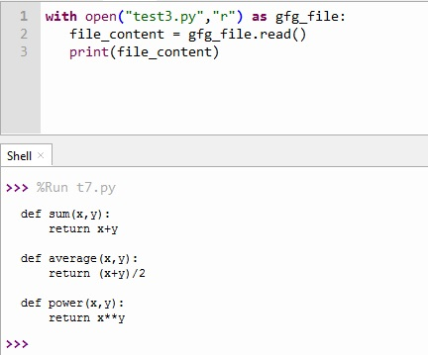
File Using With statement
Example

Slide 63
Command Line Arguments:
The arguments that are given after the name of the program in the command line shell of the operating system are known as Command Line Arguments. Python provides various ways of dealing with these types of arguments. The most common is:
Using sys.argv

Slide 64
sys module
The sys module offers variables and functions for modifying many elements of the Python runtime environment.
This module gives users access to some variables that the interpreter uses or maintains as well as functions that have close relationships with the interpreter.
One such variable is the straightforward list structure seen in sys.argv.
Its primary goals are: It is a collection of command-line options. The quantity of command line arguments is given by len(sys.argv). The name of the current Python script is sys.argv[0].

Slide 65
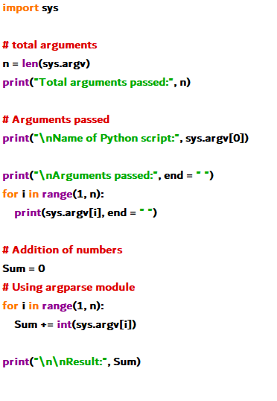
sys module
Example

Slide 66
Comma Separated Value Files
A CSV (Comma Separated Values) file is a type of plain text document that organizes tabular data using a specific format.
A comma is used to separate the data in the CSV file format, which is a bounded text document.
The document's rows are all data logs.
Each log contains one or more fields that are separated by commas.
The most widely used file format for importing and exporting databases and spreadsheets.
csv Module: The CSV module is one of the modules in Python which provides classes for reading and writing tabular information in CSV file format.

Slide 67
Comma Separated Value Files
Using csv.reader():
At first, the CSV file is opened using the open() method in ‘r’ mode(specifies read mode while opening a file) which returns the file object.
Then it is read by using the reader() method of CSV module that returns the reader object that iterates throughout the lines in the specified CSV document.
Note: The ‘with’ keyword is used along with the open() method as it simplifies exception handling
Example

Slide 68
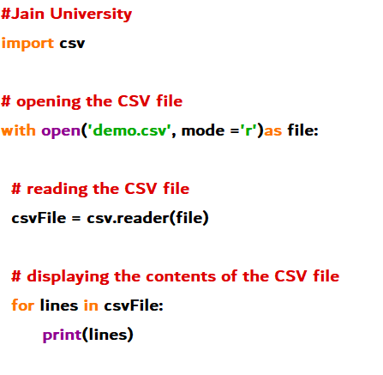
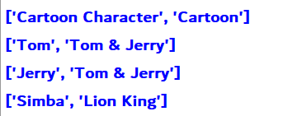
Comma Separated Value Files
Example

Slide 69
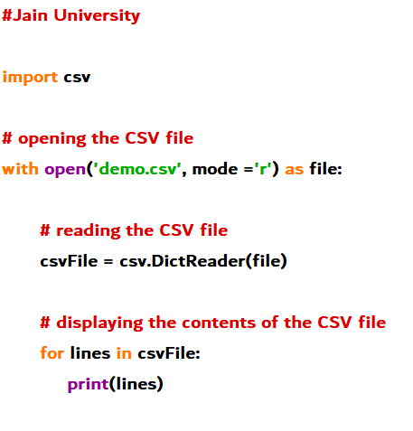
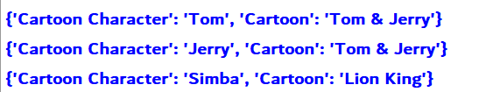
Comma Separated Value Files
Using csv.DictReader() class: the CSV file is first opened using the open() method then it is read by using the DictReader class of csv module which works like a regular reader but maps the information in the CSV file into a dictionary.
The very first line of the file consists of dictionary keys.

Slide 70
Derived Classes: Inheritance
Important feature of object oriented programming.
In inheritance, the child class acquires the properties and can access all the data members and functions defined in the parent class.
Inheritance is the capability of one class to derive or inherit the properties from another class.

Slide 71
Derived Classes: Inheritance
Benefits of inheritance are:
It represents real-world relationships well.
It provides the reusability of a code. We don’t have to write the same code again and again. Also, it allows us to add more features to a class without modifying it.
It is transitive in nature, which means that if class B inherits from another class A, then all the subclasses of B would automatically inherit from class A.
Python Inheritance Syntax:
Class derived_class(base class):
#Body of chield class..
A child class can inherit multiple class, by mentioned all parent class name.
Syntax
Class dreived-class(<base class1>, <base class 2>,….<base-class n>)
#class body

Slide 72
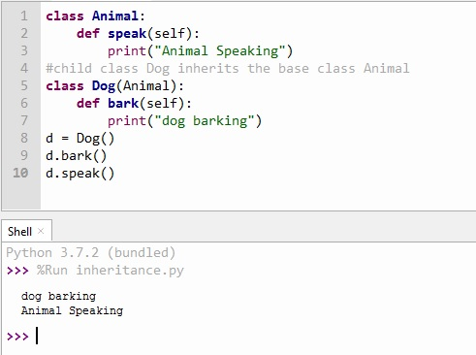
Python Inheritance Syntax:
Example

Slide 73
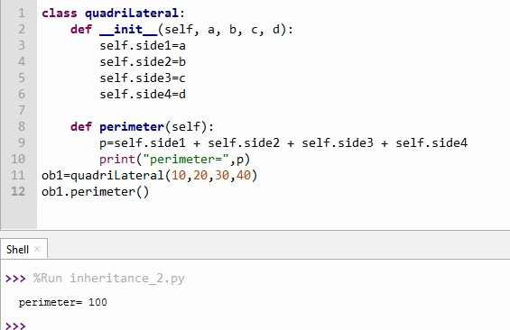
Python Inheritance Syntax:
Example_2

Slide 74
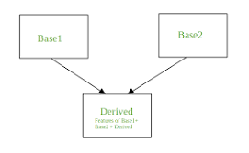
Multiple inheritances:
When a child class inherits from multiple parent classes, it is called multiple inheritances.
Syntax
Class dreived-class(<base class1>, <base class 2>,….<base-class n>)
#class body

Slide 75
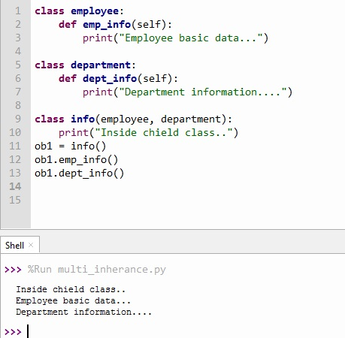
Multiple inheritances:
Example

Slide 76
Multilevel inheritance

Slide 77
Multilevel inheritance:
When a child class inherits from multiple parent classes, it is called multiple inheritances.
Syntax
Class class1:
<class body>
Class class2(class1)
<class body>
Class class3 (class2)
<class body..>

Slide 78
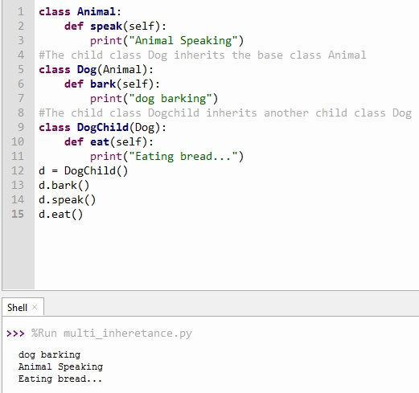
Multilevel inheritance:
Example

Slide 79
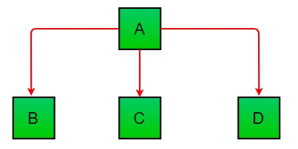
Hierarchical Inheritance:
More than one derived class are created from a single base class.

Slide 80

Hierarchical Inheritance:
Example

Slide 81

Hybrid Inheritance:
Inheritance consisting of multiple types of inheritance is called hybrid inheritance.

Slide 82

Hybrid Inheritance:
Example

Slide 83
Accessing Base Class Attributes:
A user-defined class serves as a template or prototype from which objects can be built. Classes offer a way to group together functionality and data.
A new class produces a new type of object, enabling the creation of new instances of that type.
Each instance of a class may have characteristics connected to it to preserve its state.
Class instances may additionally include methods for changing their state that are defined by their class.

Slide 84
Accessing Parent class method from inner class
An inner class or nested class is a defined inside the body of another class. If an object is created using a class, the object inside the root class can be used. A class can have one or more than one inner classes.
Types of Inner Classes:
Multiple Inner Class
Multilevel Inner Class

Slide 85

Multiple Inner Class:
A class containing more than one inner class.

Slide 86
Multilevel Inner Class:
In multilevel inner classes, the inner class contains another class which is inner classes to the previous one.

Slide 87


Multilevel Inner Class:
Example

Slide 88
Overriding Class Methods
Can provide some specific implementation of the parent class method in our child class.
When the parent class method is defined in the child class with some specific implementation, then the concept is called method overriding.
Any object-oriented programming language has the capability of allowing a subclass or child class to offer a customised implementation of a method that is already supplied by one of its super-classes or parent classes.
This capability is known as method overriding.
The term "override" refers to a method in a subclass that replaces a method in a superclass when both methods share the same name, same parameters, same signature, and same return type (or sub-type).
The object that calls a method will determine which version of the method is executed. When a method is called from an object of a parent class, the method's parent class version is executed; however, when a method is called from an object of a subclass, the child class version is executed. In other words, the version of an overridden method that is run depends on the type of the object being referenced, not the type of the reference variable.

Slide 89

Overriding Class Methods
Example

Slide 90

Overriding Class Methods
Real Time Example

Slide 91
Is-a relationship vs has-a Relationship
One of the advantages of an Object-Oriented programming language is code reuse.
There are two ways we can do code reuse either by the implementation of inheritance (IS-A relationship), or object composition (HAS-A relationship).
IS-A Relationship:
In object-oriented programming, the concept of IS-A is a totally based on Inheritance, which can be of two types Class Inheritance or Interface Inheritance.
It is just like saying "A is a B type of thing".
For example,
Apple is a Fruit, Car is a Vehicle etc.
Inheritance is uni-directional.
For example,
House is a Building. But Building is not a House.

Slide 92

Is-a relationship vs has-a Relationship
Example

Slide 93

Is-a relationship vs has-a Relationship
Composition(HAS-A) simply mean the use of instance variables that are references to other objects.
For example Maruti has Engine, or House has Bathroom.

Slide 94

Is-a relationship vs has-a Relationship
Example
Maruti class uses Engine object’s start() method via composition. We can say that Maruti class HAS-A Engine.

Slide 95
Is-a relationship vs has-a Relationship
It is easier to change the class implementing composition than inheritance.
You can't add to a subclass a method with the same signature but a different return type as a method inherited from a superclass.
Composition, on the other hand, allows you to change the interface of a front-end class without affecting back-end classes.
Composition is dynamic binding (run-time binding) while Inheritance is static binding (compile time binding)
It is easier to add new subclasses (inheritance) than it is to add new front-end classes (composition) because inheritance comes with polymorphism.
With both composition and inheritance, changing the implementation (not the interface) of any class is easy. The ripple effect of implementation changes remains inside the same class.

Slide 96

Multiple Inheritance
Multiple inheritance is an object-oriented feature that is present in many but not all programming languages.
The object doing the inheriting is the subclass; the object being inherited from, the superclass
Simple Inheritance

Slide 97

Multiple Inheritance
A subclass to inherit from multiple super classes. This is multiple inheritance

Slide 98
Multiple Inheritance
create the diamond dependency problem.
"Suppose two classes B and C inherit from A, and class D inherits from both B and C. If there is a method in A that B and C have overridden, and D does not override it, then which version of the method does D inherit: that of B, or that of C?“
Python avoid this by using Mixins

Slide 99
Mixins
Mixins are an alternative class design pattern that avoids both single-inheritance class fragmentation and multiple-inheritance diamond dependencies.
A mixin is a class that defines and implements a single, well-defined feature.
Subclasses that inherit from the mixin inherit this feature—and nothing else.
Mixins are a safe form of multiple inheritance.
Mixins are more legible than single inheritance classes.

Slide 100

Mixins
Mixin without overriding
Here we will not use any function overriding in underlines classes
Step 1: Class creation-
Lets create two or more simple python classes.

Slide 101

Mixins
Step 2: Mixin Class
In the above step, We have created two dummy classes with a different sets of functions. In this section, we will mixin them.
The most important thing is that Python gives overriding priority from right to left.
Step 3 : Calling the function –
Lets create the object of the MasterClass class. Then we will call the fun_A() and fun_B() function.

Slide 102

Mixins
Output will be..

Slide 103

Mixins
Mixin with overriding-
Step 1: Class creation with overriding function
Here are two classes with function overriding.
Step 2: Mixin class-
Let’s create a master class that inherits the mixin class.

Slide 104

Mixins
Step 3: Object creating and function calling-
After creating the object of MasterClass and then we will invoke the fun() function.
fun() is common on both the mixin class. Lets see which one is invoke!
It is invoking the fun() definition of Example_mixin_class2 because of Python Right to Left Hirarchy.
.

Slide 105

Mixins
Output

Slide 106

Mixins
If we change the order then it will invoke the function of Example_mixin_class1
Output

Slide 107
Thank You!

